Slide 1
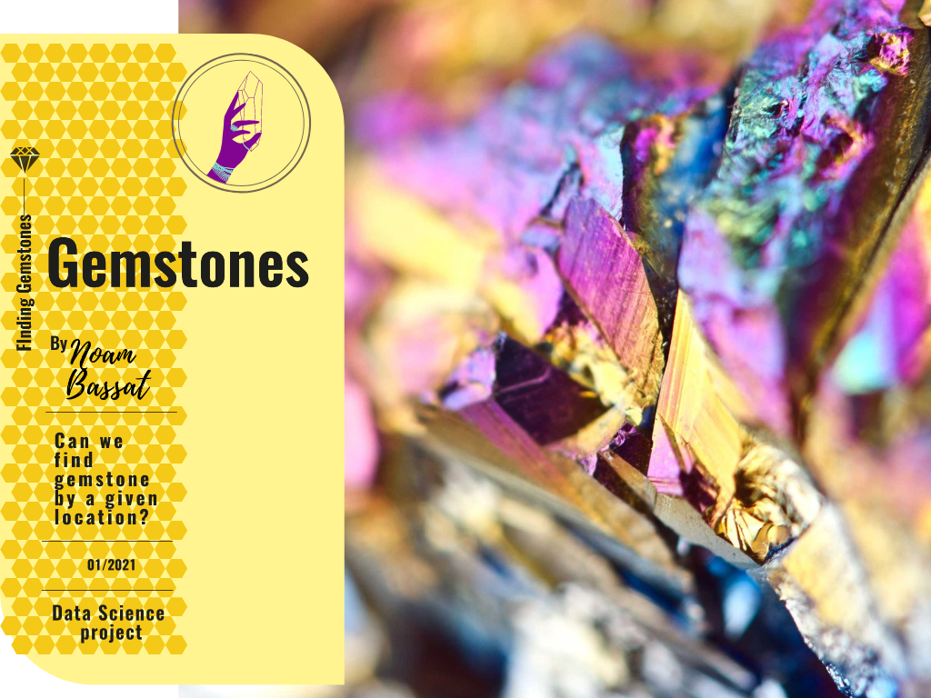

Slide 2
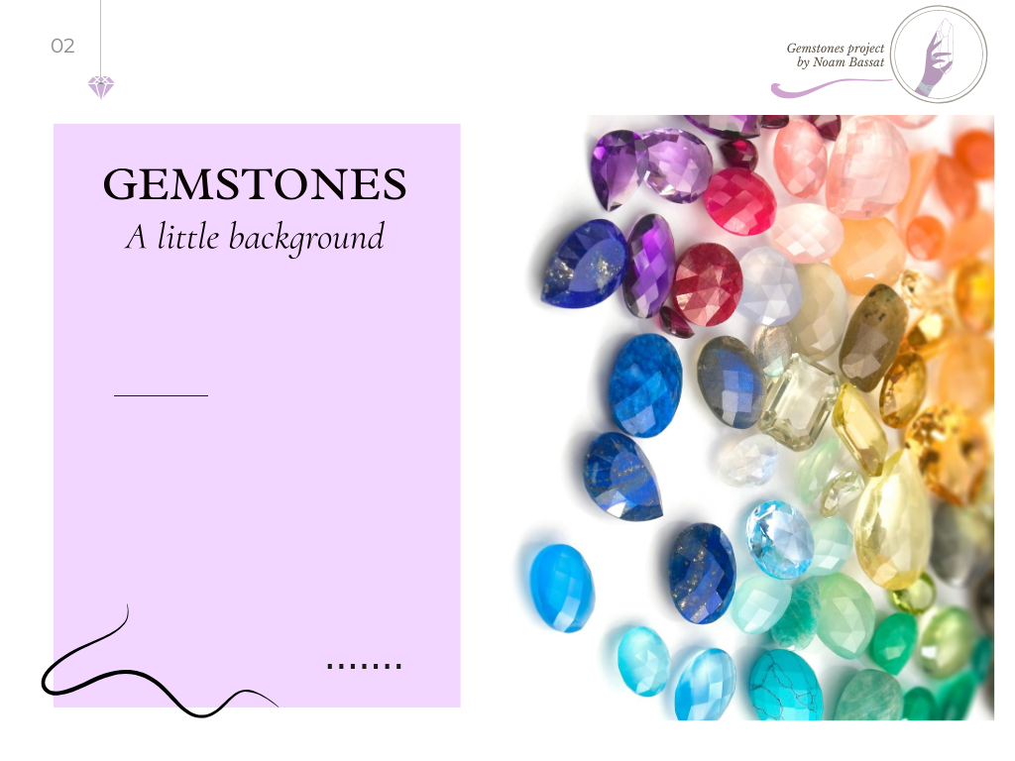
Gemstones are naturally formed mineral crystals which when cut and polished reveal their beauty.
They are created inside the earth when the right physical conditions occur. They are brought to the surface by various geological forces and can be carried away by rivers before they are deposited. They are defined by their chemical formula and trace minerals as well as their crystal structure. Of the more than 2,000 identified natural minerals, fewer than 100 are
used as gemstones and only 16 have achieved importance.

Slide 3
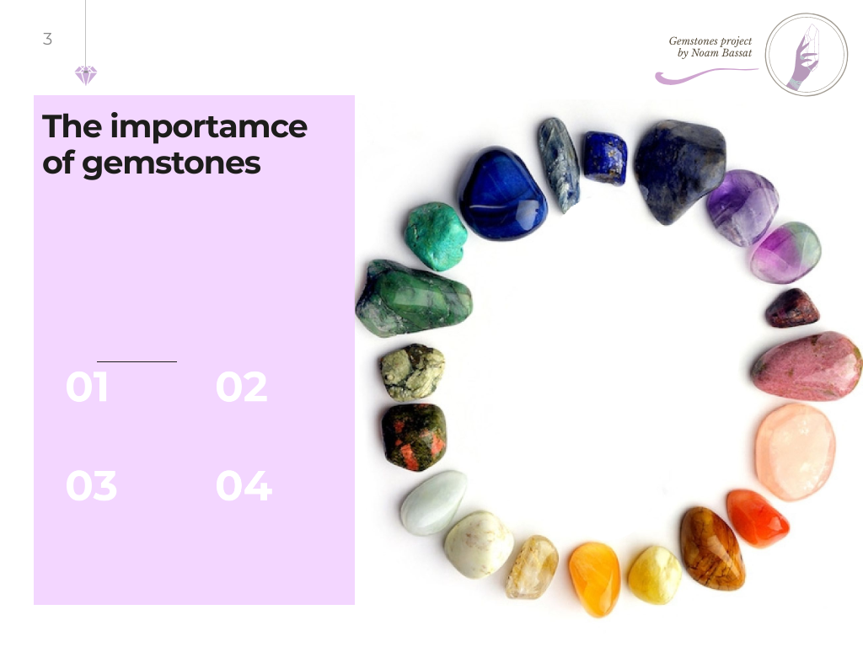
Gemstones have been chosen for their beauty and durability, then cut and polished mainly for use as human adornment.
Jewelry and ornamental purposes
Health, religion and spiritual benefits
Status symbol and economical value
Scientific and industrial uses

Slide 4
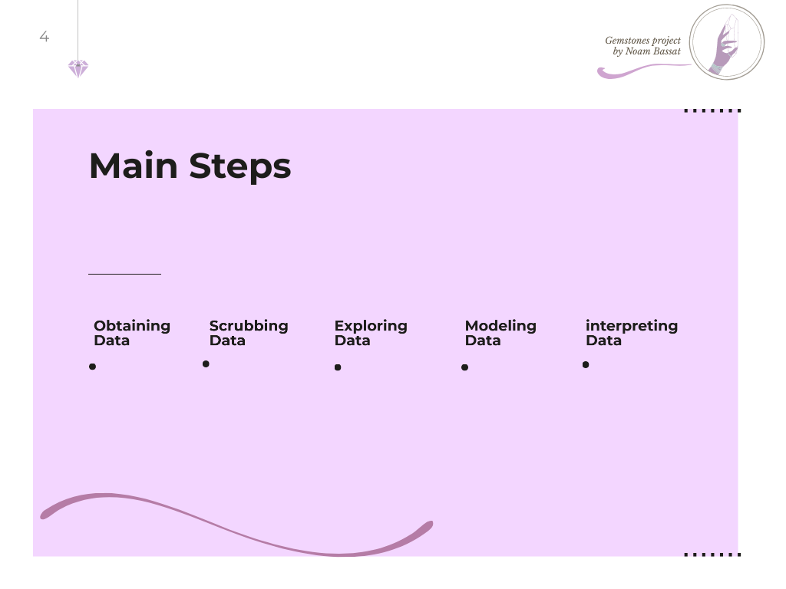
Main process steps of the project
1
2
3
4
5
Web crawling for collecting and obtaining the data
Cleaning, formatting, and filtering the data
Visualizing and understanding the data
Clustering the data into groups, modeling and the algorithm
Presentation of data, understanding and delivering the results + Final predict model

Slide 5
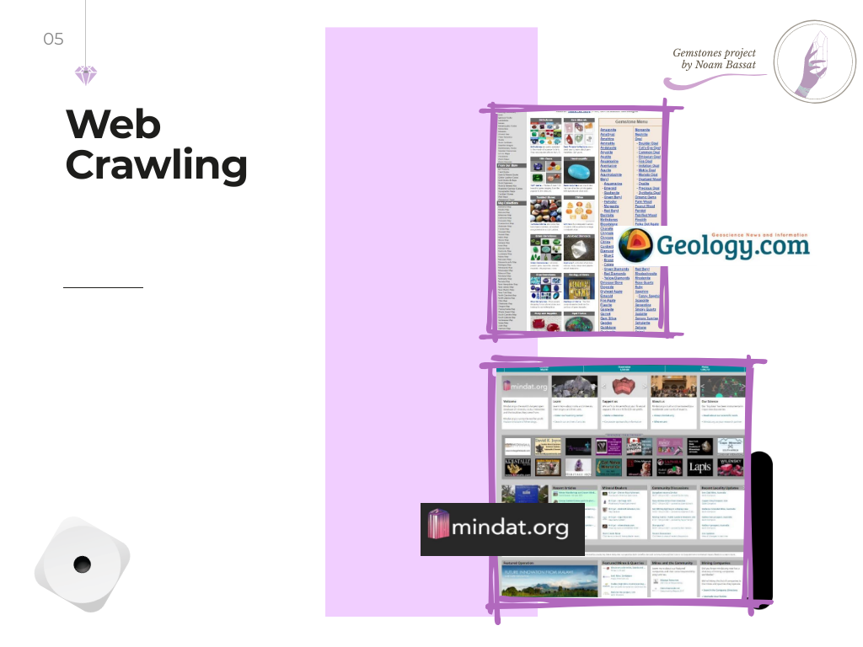
Finding main gemstones to explore, and crawling their data
Gemstones list
Gemstones and Locations
From “mindat.org” I took every relevant information about the gemstone. After I had their locations references, I took the relevant details of each location, and put it into a different dataframe.
From “Geology.com” I took the main gemstones list that I wanted to explore.
Main tools:
BeautifulSoup and Selenium

Slide 6
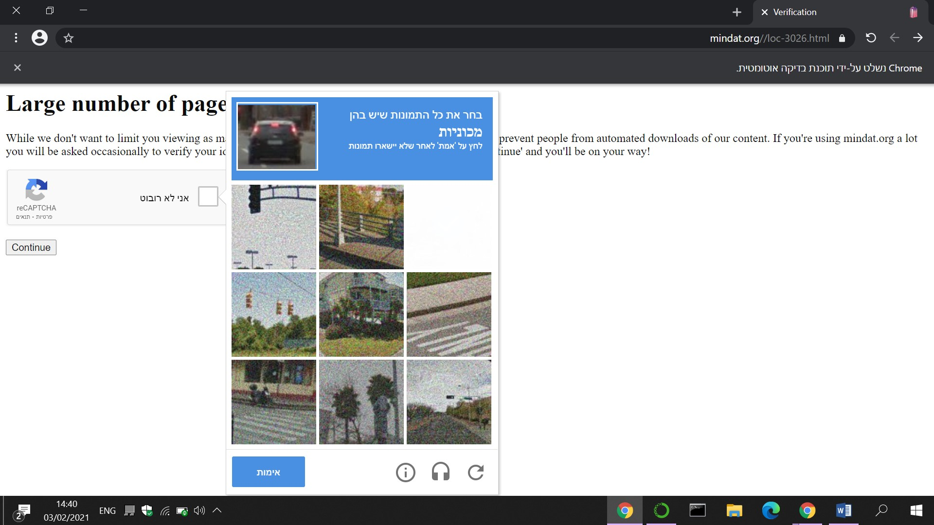
But, not every thing was so easy…
After a number of pages visits, the “Midnat” Site wanted to check if I am a bot. of course I am not, but my program is. So, I made my calculations and found out that this bot-checker appears every 23 minutes. (including the sleeping and searching time). So, I had to stay close, and pass the test every 23 minutes. Finally, after 5 and a half hours, I had a dataset that contains 2,621 locations records, and another dataset that contains information about 77 gemstones.

Slide 7

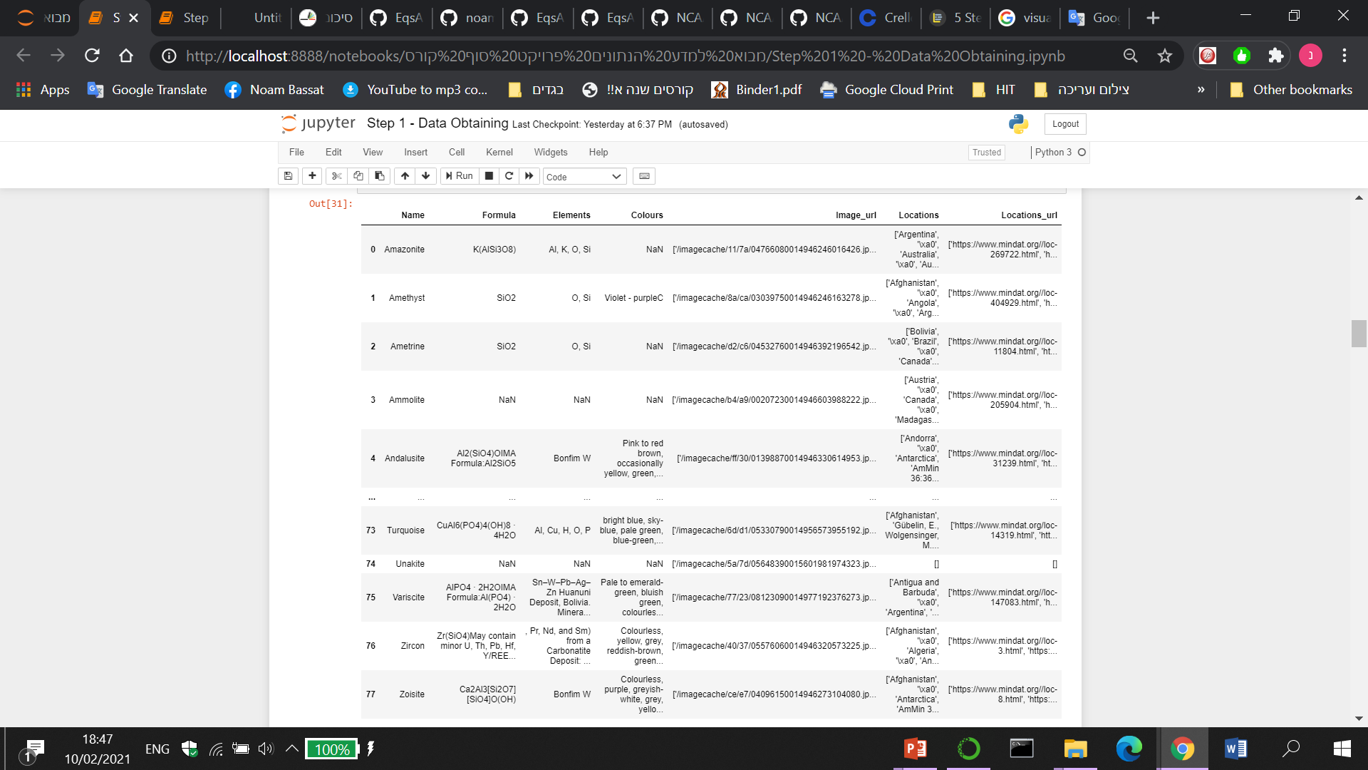
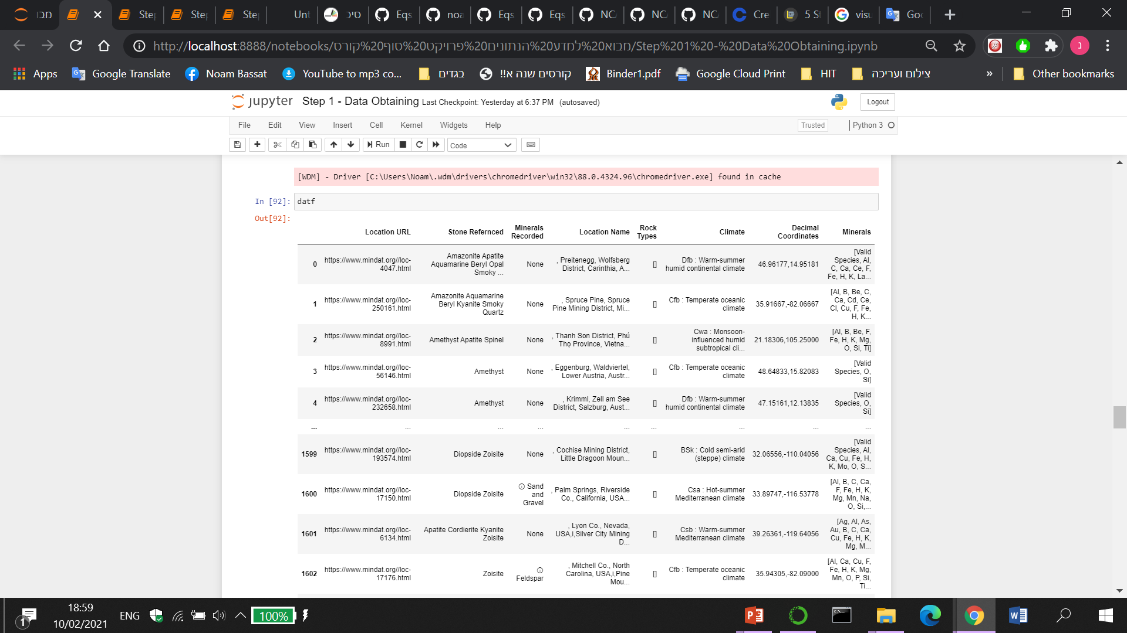
Locations Dataframe
Gemstones Dataframe

Slide 8

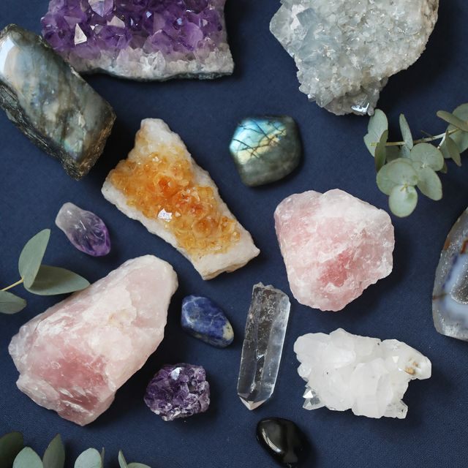
Scrubbing Data
Dealing with missing values:
Dropping rows and columns with too many missing values.
Dealing with duplicates;
I have a tiny number of duplicates rows, which contained the exact same values, so I kept only the first ones.
Cleaning the noise:
Many strings contained unnecessary signs, duplicated words and so on, so I built some “cleaning” methods.
Formatting:
Importing every non–numeric variable into a fitted categorical data. Also, splitting columns such as coordinates into two columns, one for the latitude value and one for the longitude.

Slide 9
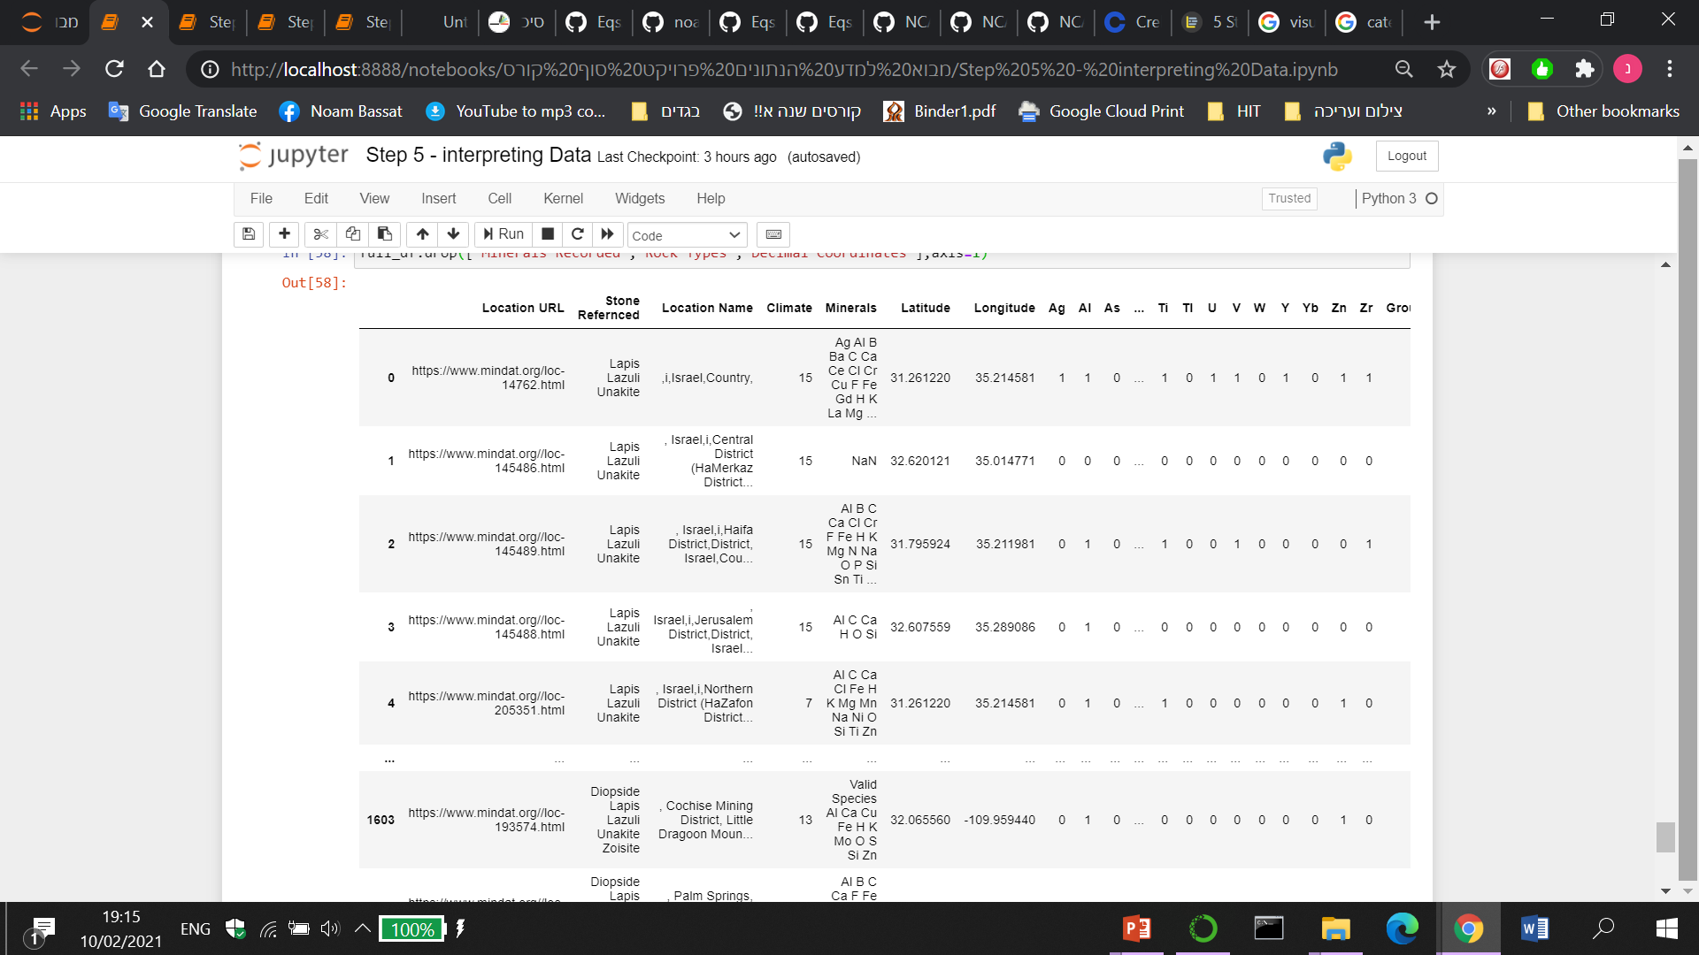
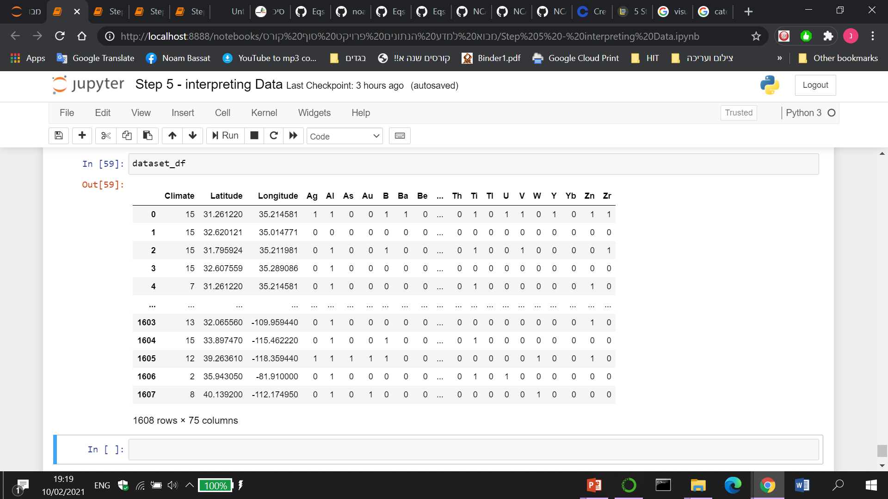
Full - Locations Dataframe
Locations Dataset

Slide 10

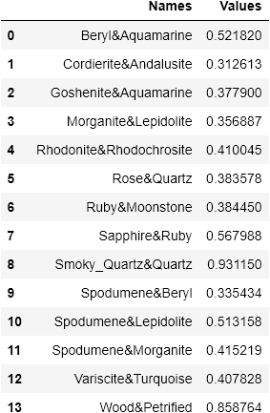
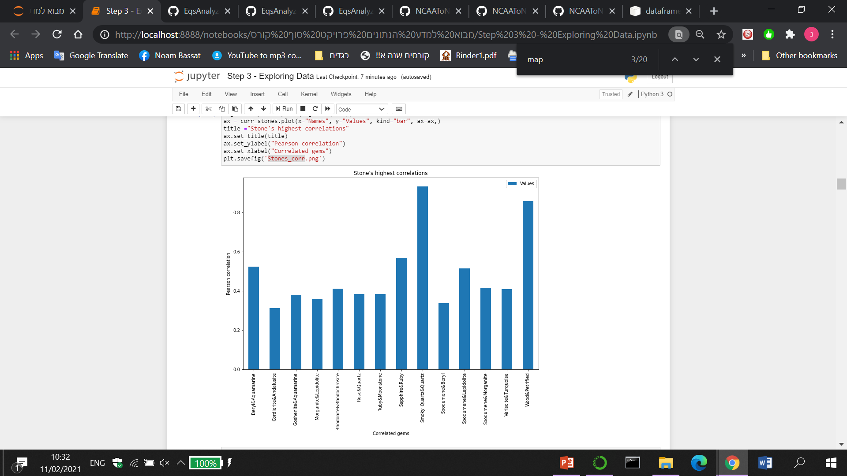
Exploring & visualizing the Data
After seeing the correlations I dropped one of two stones that appeared to be the exact same stone. Stones and minerals such as: “Lapis” and “Lasuli”, “Titanite” and “Sphene” and more..

Slide 11
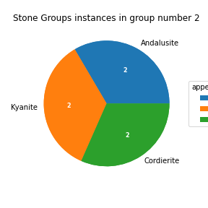
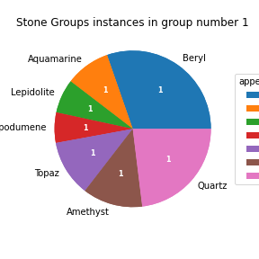
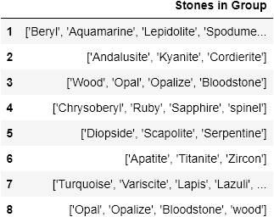
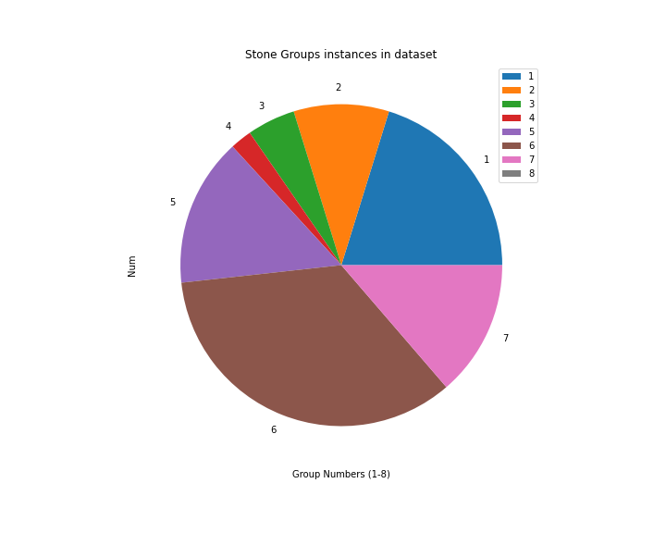
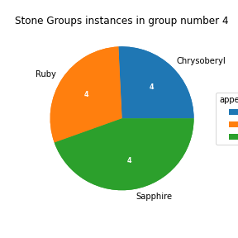
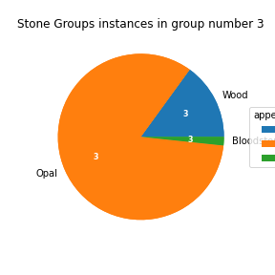
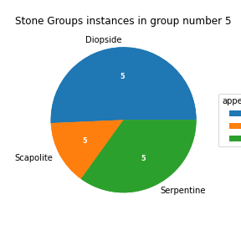
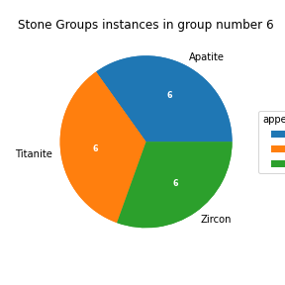
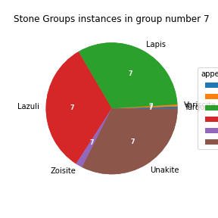
Exploring & visualizing the Data
Splitting the Stones into correlated stone groups

Slide 12
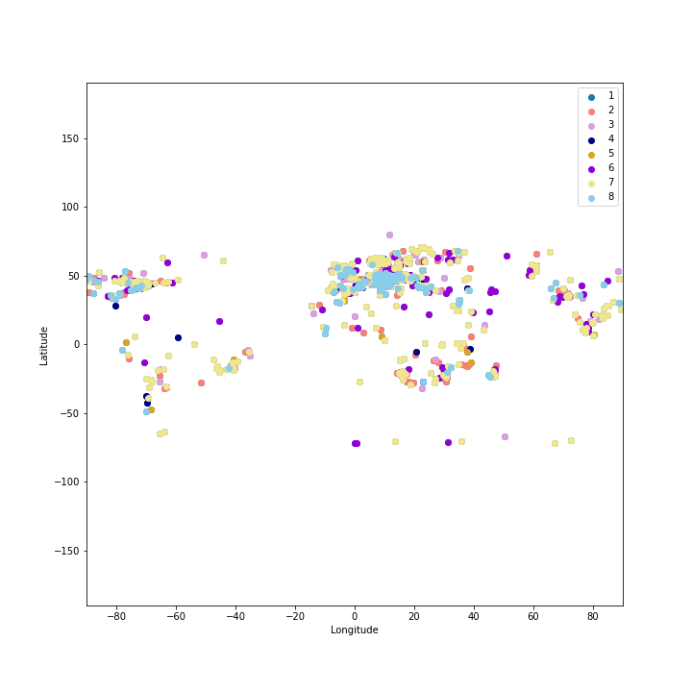
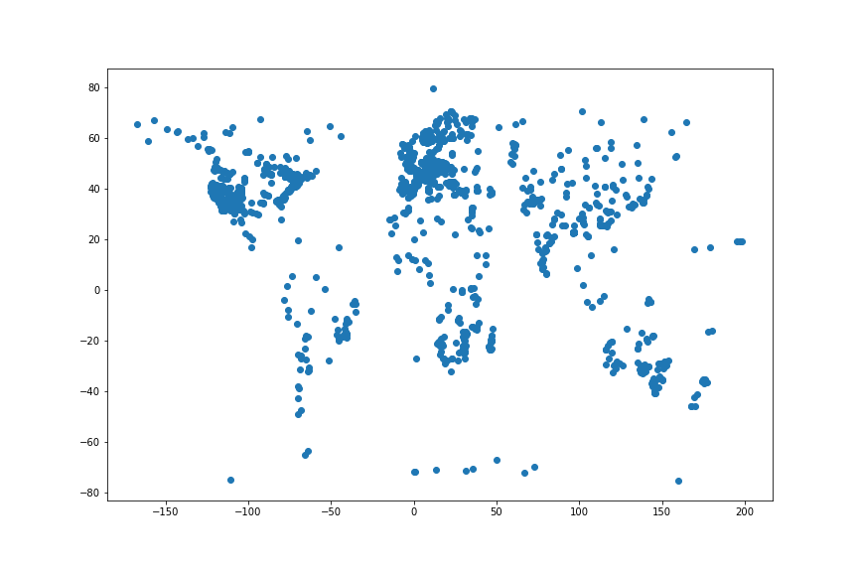
Exploring & visualizing the Data
Visualizing locations with scatter plot
Group map
No significant separation can be seen in the group graph…

Slide 13
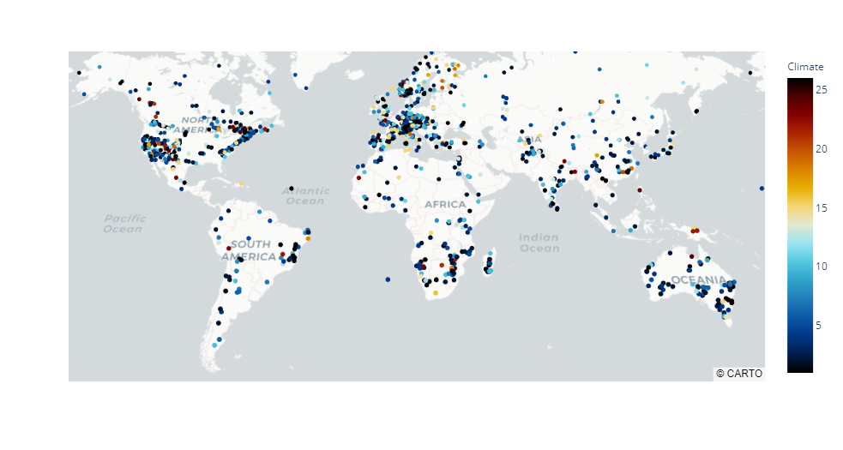
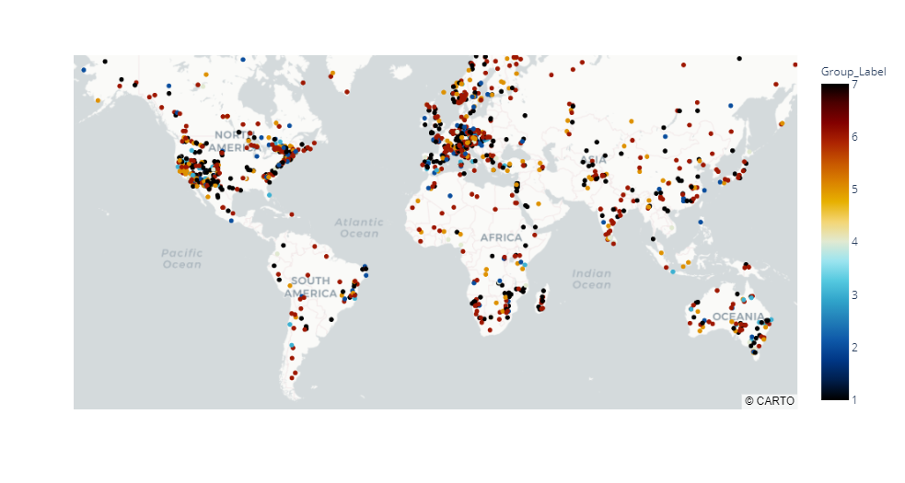
Exploring & visualizing the Data
Mapping scatter plot
With plotly.express
There was a tiny amount of outliers that I didn’t want to drop, so I manually fixed their coordinates..
After fixing the outliers

Slide 14
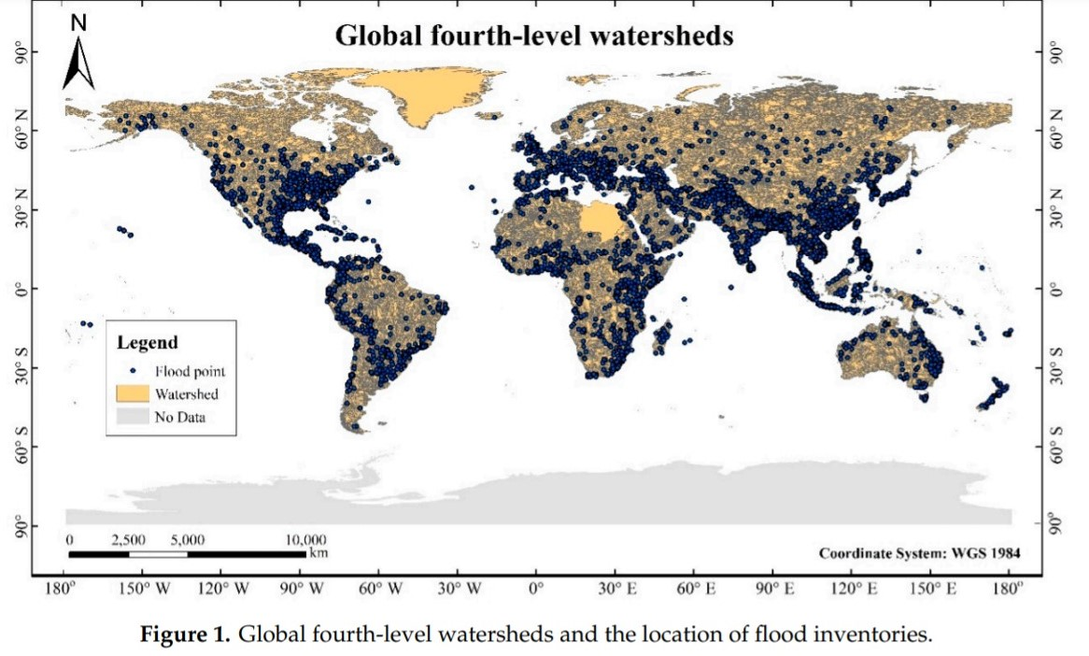
Exploring & visualizing the Data
"Gemstone deposits that are carried by rivers are called placers or alluvial deposits. Rivers can transport gem-bearing rock many hundreds of miles. When the force of the current diminishes, the denser gems, such as diamond, zircon, garnet, sapphire, chrysoberyl, topaz, peridot and tourmaline, are deposited before the lighter quartz sand. Thus the gems left behind by the river tend to be concentrated in certain places. This makes mining the deposit much easier and more productive.“
https://www.gemselect.com/english/other-info/gemstone-deposits.php
Can you see the similarity?
Image source: https://www.mdpi.com/2073-4441/11/8/1654 From machine learning research article

Slide 15
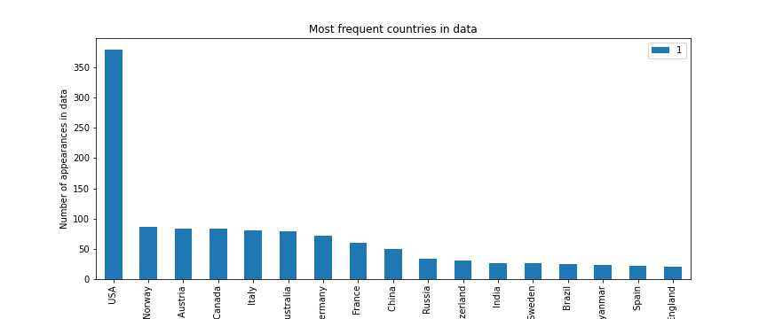
Exploring & visualizing the Data
Visualizing Countries
Based on the number of USA's instances in this graph, we would expect to see the largest collection of gems there, on the previous scatter plot. However, in the scatter plot graph, you could see that Europe has no less gems instances. The way to explain that, is that the USA is simply spread over a much larger geographical area compared to European countries. If this graph had been divided by continents instead of countries, the findings in this graph would probably have been more similar to the previous ones.

Slide 16

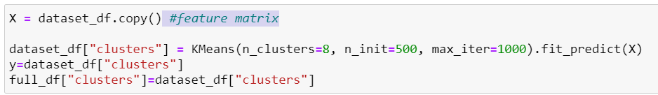
Modeling Data
Part 1 – Unsupervised Learning: Clustering by Kmeans
Unfortunately, my division into groups gave really poor results when it came to the machine learning phase. I tried to apply many algorithm models based on my groups labels, but the best accuracy they gained was lower the 0.1
So, the Kmeans algorithm has created some new clustering for me…
And it did it much better than I did.
Now that I have 8 clusters I tried some supervised models again and the accuracy has increased multiple times.

Slide 17
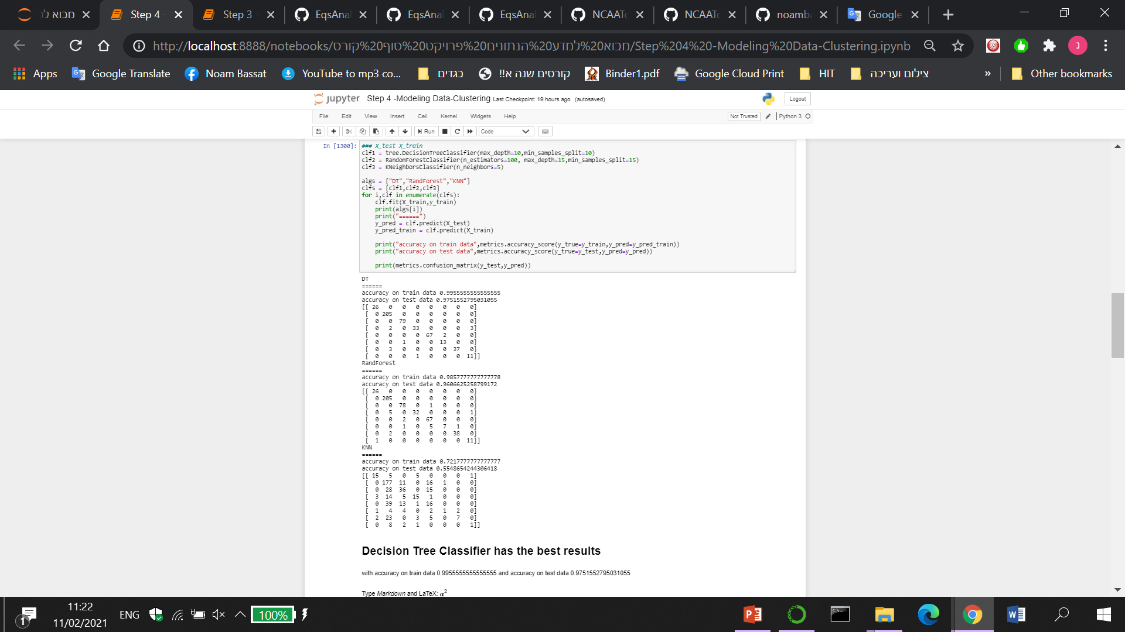
Modeling Data
Part 2 – Supervised Learning: Comparison of the performance of 3 supervised algorithms: RandomForestClassifier, DecisionTreeClassifier, and KNN,
using Sklearn.

Slide 18
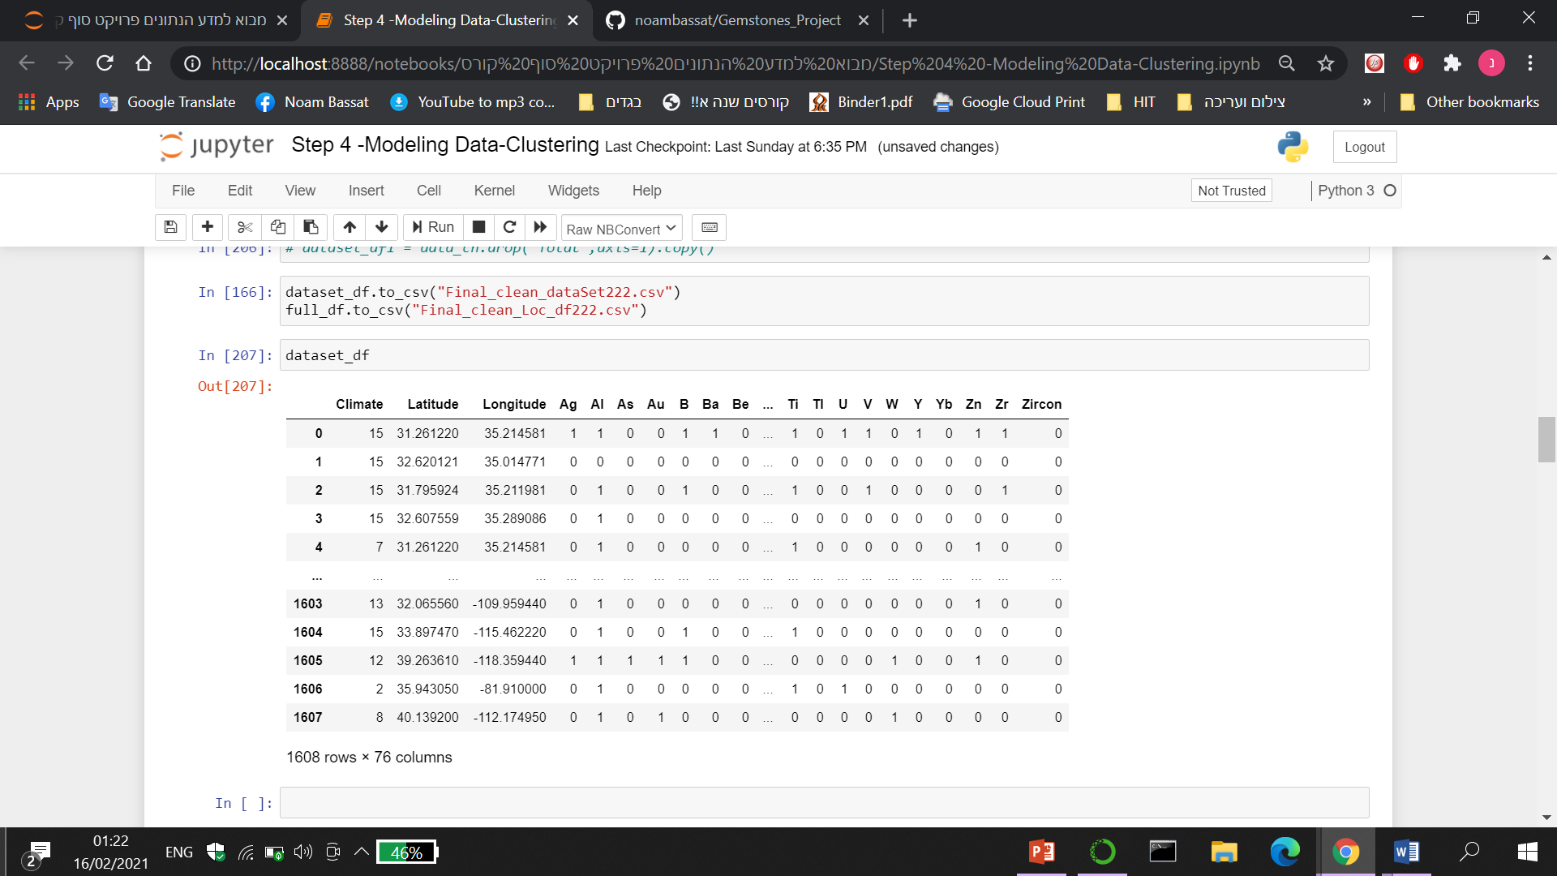
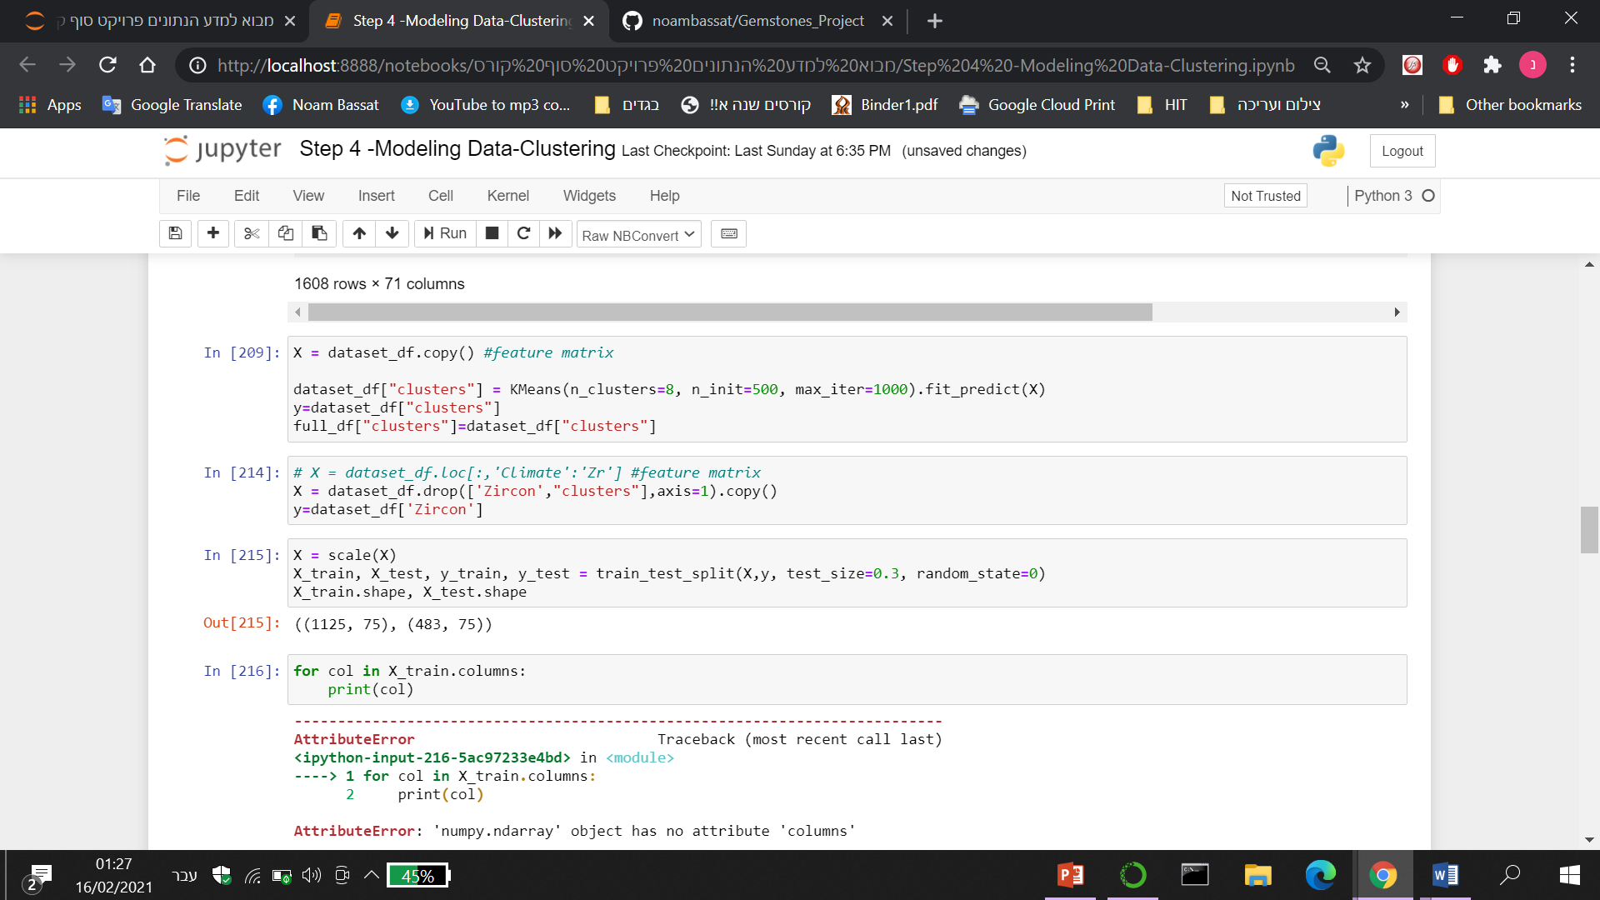
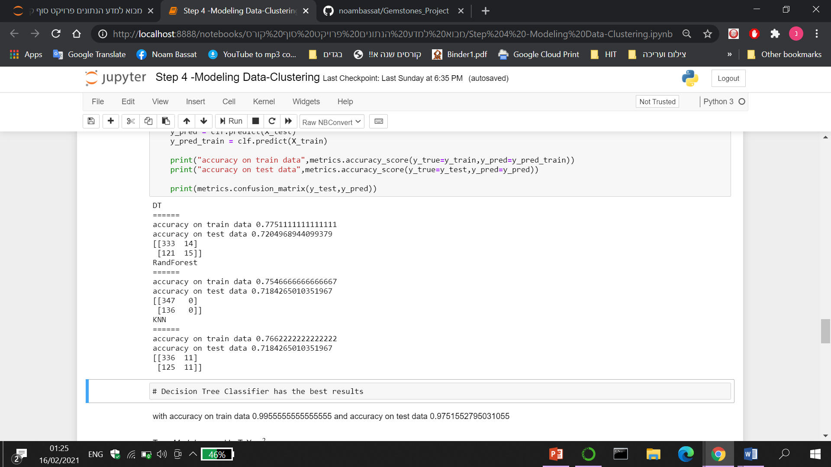
Modeling Data
One stone model
I added another binary column for zircon and tested if the algorithm can predict by location whether there are zircons or not.
Note:
I ran the same algorithm on Diamonds, which gained an accuracy of 0.98. The problem with that, is that Diamond appeared only in 29 records of the data.
Even if the machine will predict 0 for every location, the accuracy will be around 0.98…

Slide 19

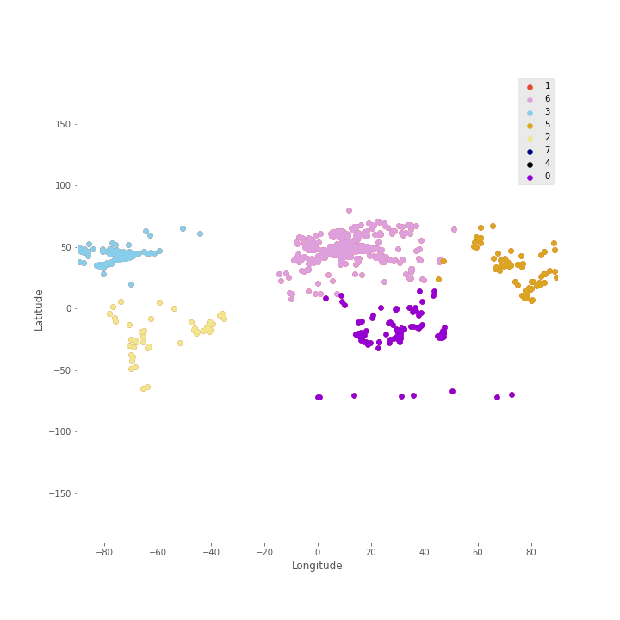

Scatter plot by kmean’s clusters

Slide 20
Results
Attributes of Kmean’s Clusters
Cluster 7 | Cluster 6 | Cluster 5 | Cluster 4 | Cluster 3 | Cluster 2 | Cluster 1 | Cluster 0
53 | 125 | 261 | 102 | 104 | 216 | 68 | 679 | Number of locations
42.901839 75.451651- | 19.690474-, 29.756632 | 30.223338, 82.134699 | 39.803252, 123.978676 | 29.315328-, 143.127625 | 39.069659, 112.783420- | 48.719148, 11.227510 | 20.895355-, -56.725037 | Average coordinates
19.639860, 94.661670- | 72.000000-, 0.083330 | 4.650000-, 45.083330 | 16.262780, 101.270000 | 75.283330-, 107.731640 | 16.883330, 166.854170- | 7.495260 14.492780- , | -74.700000, 110.666670- | Min Coordinates
67.399170, 44.152500- | 14.000000 72.500000 | 66.916670, 107.200000 | 70.880000, 164.733330 | 2.330250-, 179.958330 | 67.061940, 93.736110- | 79.799840, 51.061020 | 5.632360, 35.270000- | Max Coordinates
1 Dfb : Warm-summer humid continental climate | 7 BSh : Hot semi-arid (steppe) climate | 3 Cwa : Monsoon-influenced humid subtropical climate | 5 Cfa : Humid subtropical climate | 2 Cfb : Temperate oceanic climate | 13 BSk : Cold semi-arid (steppe) climate | 2 Cfb : Temperate oceanic climate | 6 Aw : Tropical savanna, wet | Most frequent Climate
Ag Al As Au B Ba | Ag Al As Au B Ba Be | Ag Al As Au B | Ag Al As Au B Ba Be | Ag Al As Au B Ba Be Bi | Ag Al As Au B Ba Be | Ag Al As Au B Ba Be Bi Br C Ca Cd Ce | Ag Al As Au B Ba Be Bi | Most significant minerals

Slide 21
Stones in each of kmean’s clusters, sorted by their appearance in the data
Cluster 7 | Cluster 6 | Cluster 5 | Cluster 4 | Cluster 3 | Cluster 2 | Cluster 1 | Cluster 0
Total stones 191 Sphene 21 Zircon 17 Diopside 17 Serpentine 7 Spinel 5 Azurite 5 Chrysoberyl 5 Beryl 5 Rhodonite 5 Topaz 5 Zoisite 5 Sodalite 4 Amethyst 4 Opal 3 Quartz 3 Kyanite 3 Cordierite 3 Rhodochrosite 3 Scapolite 3 Ruby 2 Smoky Quartz 2 Andalusite 2 Emerald 2 Lepidolite 2 Sapphire 2 Jade 1 Spodumene 1 Nephrite 1 Labradorite 1 Diamond 1 Variscite 1 | Total stones 861 Quartz 92 Smoky Quartz 70 Sphene 68 Zircon 58 Beryl 44 Diopside 44 Amethyst 38 Serpentine 37 Aquamarine 26 Scapolite 25 Opal 23 Kyanite 22 Rose 18 Spinel 18 Spodumene 15 Azurite 14 Sodalite 9 Lepidolite 9 Andalusite 8 Morganite 8 Heliodor 8 Amazonite 7 Rhodochrosite 7 Topaz 7 Citrine 6 Cordierite 6 Zoisite 5 Sapphire 5 Labradorite 5 Sunstone 5 Variscite 4 Turquoise 4 Chrysoberyl 3 Rhodonite 3 Wood 3 Goshenite 2 Garnet 2 Jadeite 2 Petrified 2 Red 2 Tourmaline 2 Jade 1 Charoite 1 Hematite 1 Nephrite 1 Opalized 1 Ruby 1 Diamond 1 | Total stones 397 Zircon 27 Beryl 27 Quartz 26 Sphene 24 Aquamarine 22 Smoky Quartz 18 Diopside 15 Topaz 15 Spinel 15 Sapphire 11 Serpentine 11 Amethyst 10 Lepidolite 9 Ruby 9 Opal 8 Emerald 8 Rose 8 Goshenite 8 Azurite 7 Kyanite 7 Sodalite 7 Morganite 6 Diamond 6 Spodumene 6 Andalusite 5 Chrysoberyl 5 Cordierite 4 Zoisite 3 Scapolite 3 Citrine 2 Labradorite 1 Tourmaline 1 Garnet 1 Iolite 1 Amazonite 1 Variscite 1 Rhodonite 1 Chrysoprase 1 Rhodochrosite 1 Peridot 1 | Total stones 211 Zircon 22 Beryl 14 Quartz 12 Aquamarine 12 Sphene 11 Smoky Quartz 10 Emerald 8 Spinel 7 Diopside 7 Amethyst 6 Opal 6 Spodumene 5 Lepidolite 5 Kyanite 4 Cordierite 4 Serpentine 4 Chrysoberyl 3 Zoisite 3 Azurite 3 Wood 3 Rose 2 Sapphire 2 Goshenite 2 Citrine 2 Diamond 2 Topaz 2 Opalized 2 Andalusite 2 Jadeite 2 Morganite 2 Labradorite 1 Rhodochrosite 1 Petrified 1 Rhodonite 1 Sodalite 1 | Total stones 504 Sphene 37 Diopside 35 Zircon 34 Spinel 25 Quartz 20 Serpentine 20 Beryl 20 Aquamarine 18 Smoky Quartz 16 Amethyst 16 Topaz 15 Azurite 15 Sapphire 12 Ruby 12 Cordierite 11 Andalusite 9 Scapolite 9 Lepidolite 7 Spodumene 7 Sodalite 7 Rhodochrosite 6 Heliodor 6 Emerald 6 Chrysoberyl 5 Moonstone 5 Rhodonite 4 Zoisite 4 Goshenite 4 Morganite 4 Labradorite 4 Rose 4 Kyanite 3 Opal 2 Citrine 2 Turquoise 2 Aventurine 2 Jadeite 2 Iolite 1 Fire 1 Agate 1 Petrified 1 Wood 1 Tourmaline 1 Sunstone 1 Peridot 1 | Total stones 766 Quartz 56 Azurite 51 Zircon 44 Smoky Quartz 40 Diopside 39 Opal 37 Sphene 36 Beryl 36 Amethyst 34 Serpentine 32 Rhodochrosite 31 Aquamarine 20 Rose 14 Rhodonite 14 Spinel 12 Wood 12 Morganite 12 Heliodor 12 Andalusite 12 Zoisite 10 Topaz 10 Petrified 10 Citrine 10 Spodumene 9 Lepidolite 9 Scapolite 8 Cordierite 8 Goshenite 6 Turquoise 6 Kyanite 6 Sodalite 4 Chrysoberyl 3 Variscite 3 Sapphire 3 Diamond 3 Nephrite 3 Jade 3 Labradorite 3 Emerald 2 Ruby 2 Moonstone 2 Opalized 2 Amazonite 1 Benitoite 1 Fluorite 1 Bloodstone 1 Agate 1 Opalite 1 Hematite 1 Tourmaline 1 Iris 1 Sunstone 1 Peridot 1 | Total stones 2348 Sphene 252 Zircon 186 Quartz 169 Smoky Quartz 154 Diopside 116 Azurite 103 Amethyst 86 Beryl 82 Serpentine 81 Spinel 64 Opal 55 Andalusite 49 Cordierite 47 Kyanite 46 Zoisite 46 Aquamarine 42 Rhodochrosite 38 Topaz 31 Scapolite 28 Sodalite 28 Labradorite 18 Rhodonite 16 Sapphire 14 Rose 12 Lepidolite 11 Diamond 11 Variscite 10 Chrysoberyl 9 Turquoise 9 Ruby 9 Citrine 8 Wood 7 Petrified 5 Spodumene 5 Heliodor 4 Emerald 4 Jadeite 3 Goshenite 2 Iolite 2 Gaspeite 2 Garnet 2 Opalized 2 Jade 2 Moonstone 2 Bloodstone 2 Nephrite 2 Sit 2 Amazonite 2 Fluorite 2 Chrysoprase 1 Maw 1 Fire 1 Malachite 1 Sunstone 1 Hematite 1 Moldavite 1 Agate 1 | Total stones 319 Zircon 24 Diopside 20 Sphene 19 Quartz 17 Beryl 16 Opal 16 Azurite 15 Smoky Quartz 14 Spinel 10 Serpentine 10 Aquamarine 8 Sapphire 8 Topaz 8 Scapolite 7 Zoisite 6 Emerald 6 Variscite 5 Diamond 5 Lepidolite 4 Kyanite 4 Heliodor 4 Amethyst 4 Rhodochrosite 4 Andalusite 4 Ruby 3 Turquoise 3 Cordierite 3 Gaspeite 2 Goshenite 2 Rhodonite 2 Rose Quartz 2 Sodalite 2 Moonstone 2 Wood 2 Spodumene 2 Chrysoprase 1 Jade 1 Amazonite 1 Malachite 1 Sphalerite 1 Petrified 1 Opalized 1

Slide 22
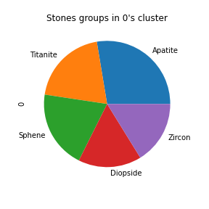
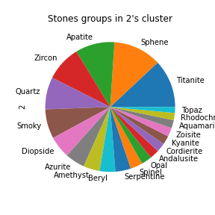
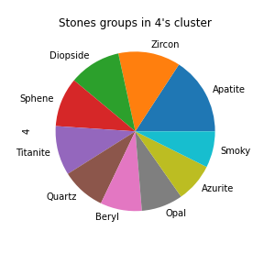
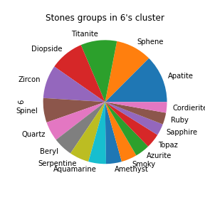
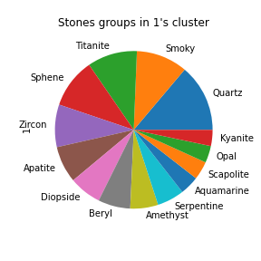
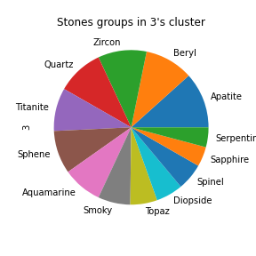
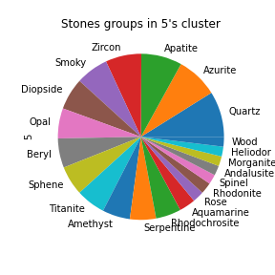
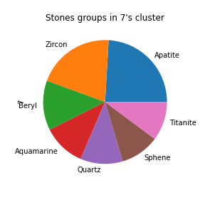
Stones in each of kmean’s clusters, sorted by their appearance in the data

Slide 23
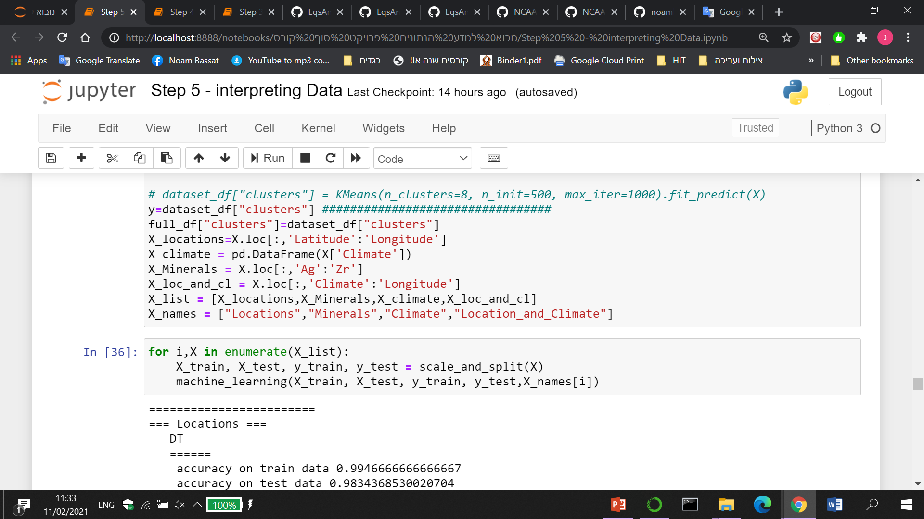
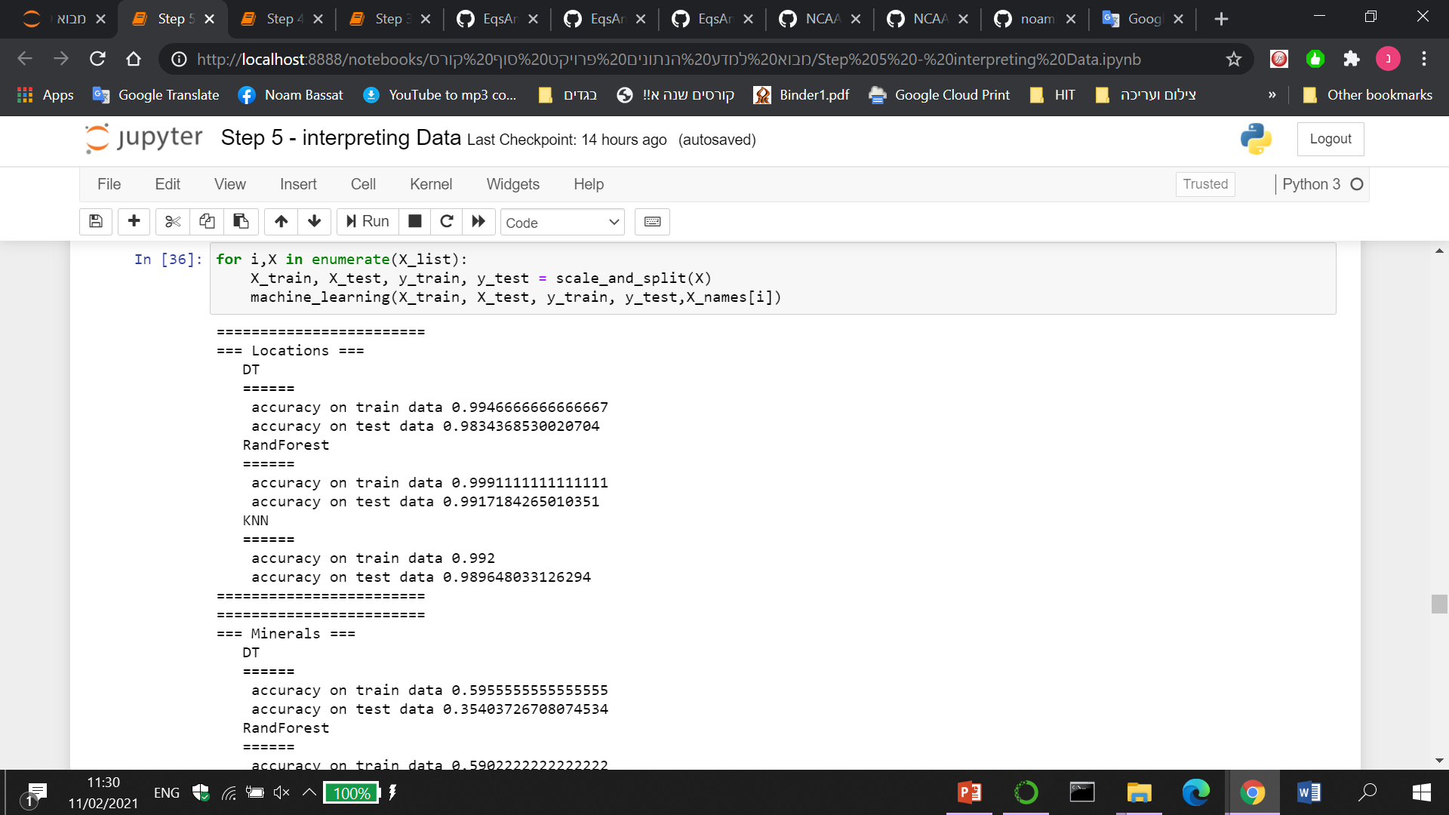
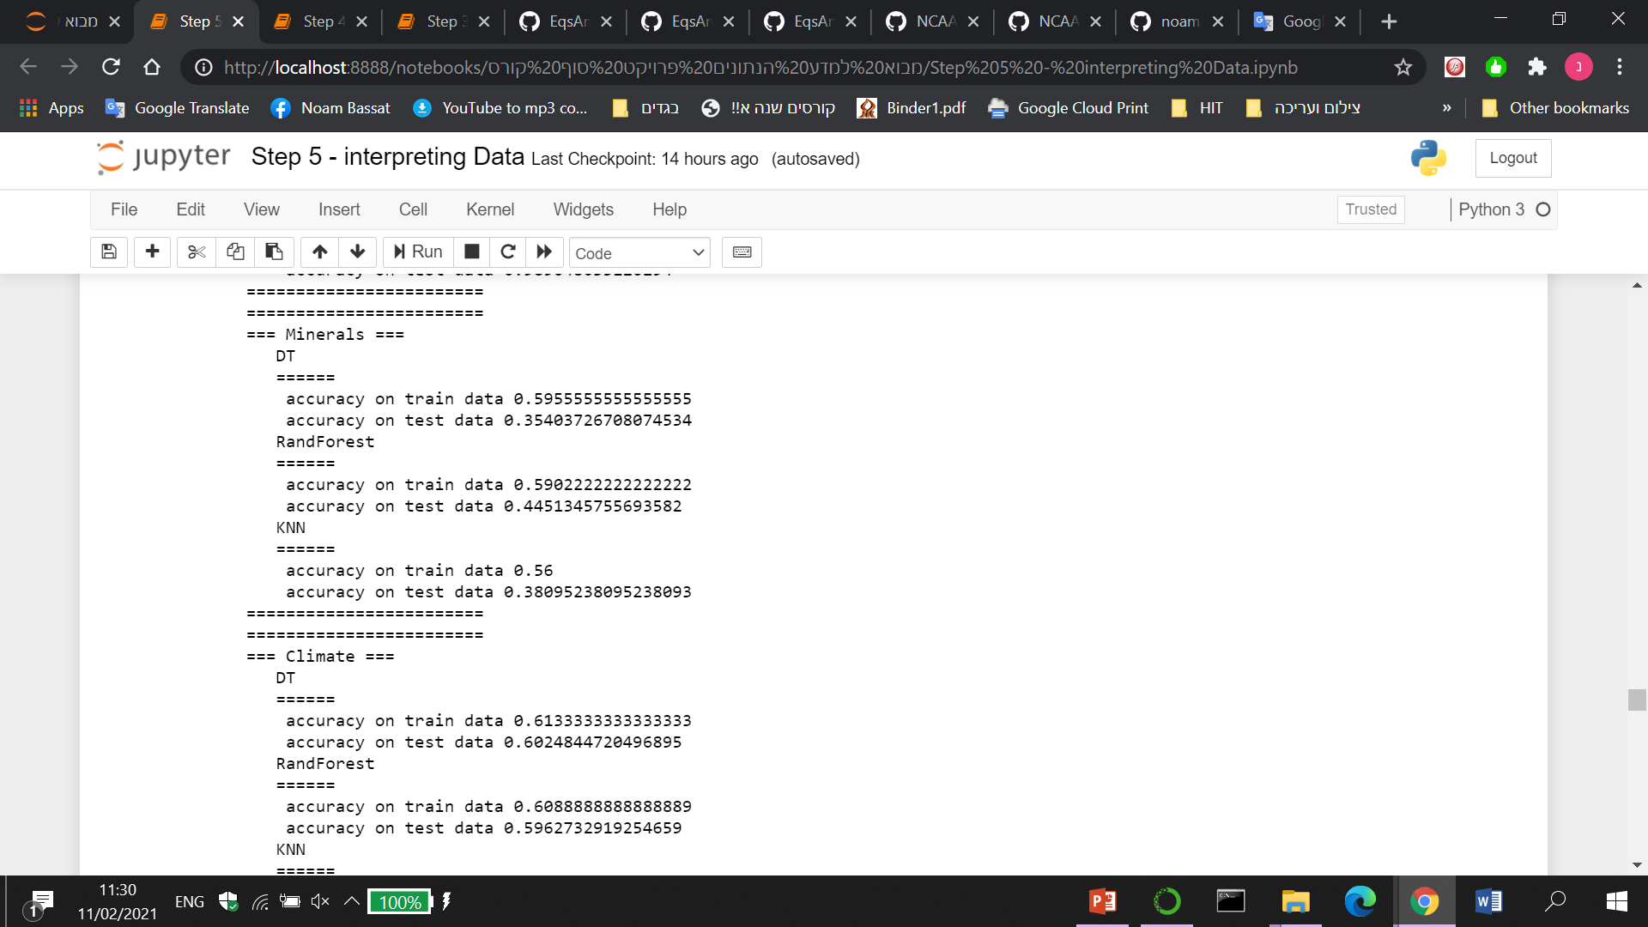
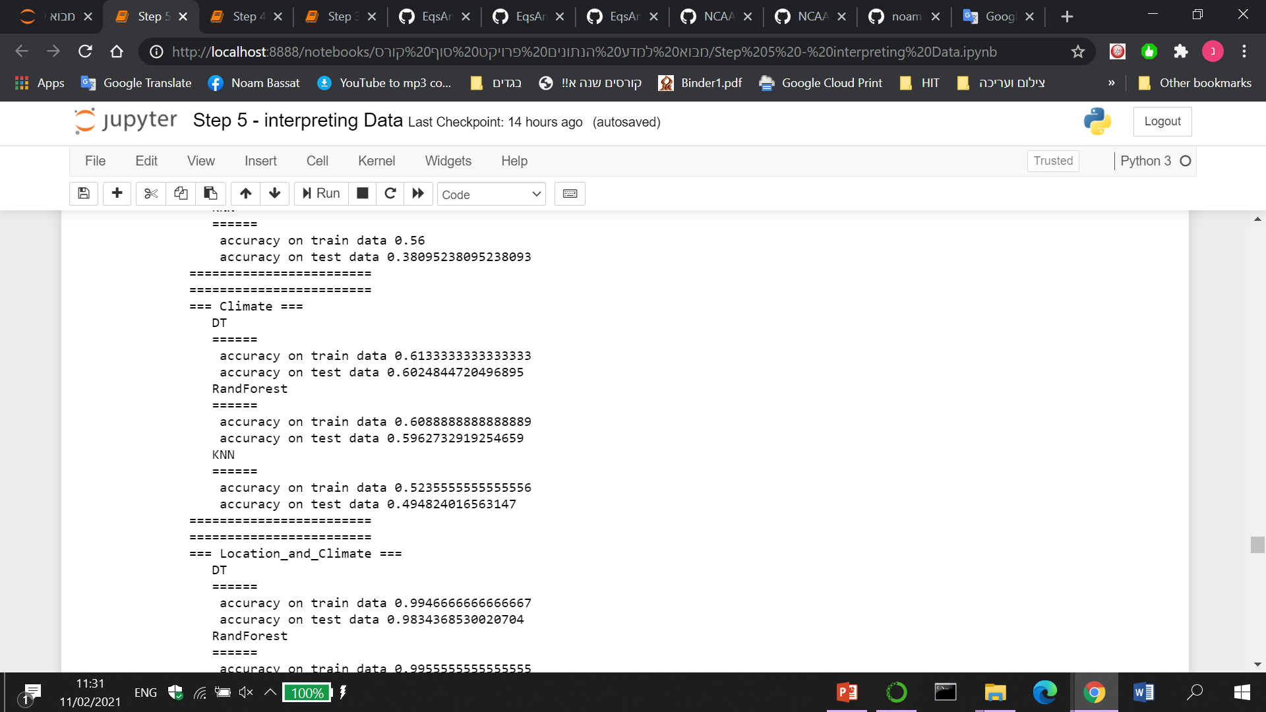
Accuracy change based on specific features

Slide 24
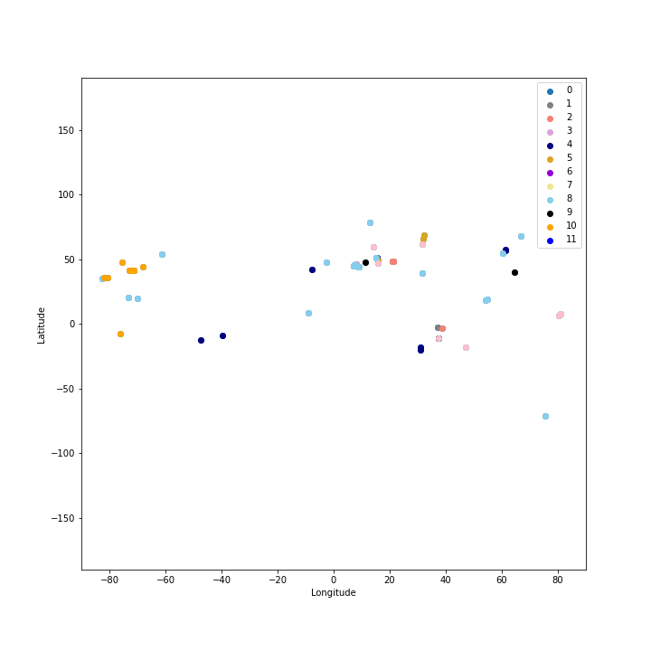
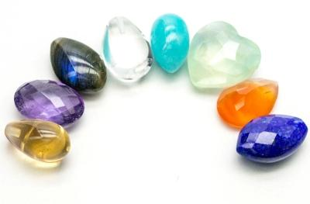
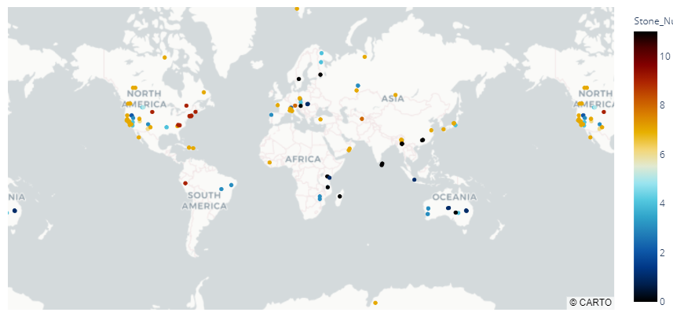
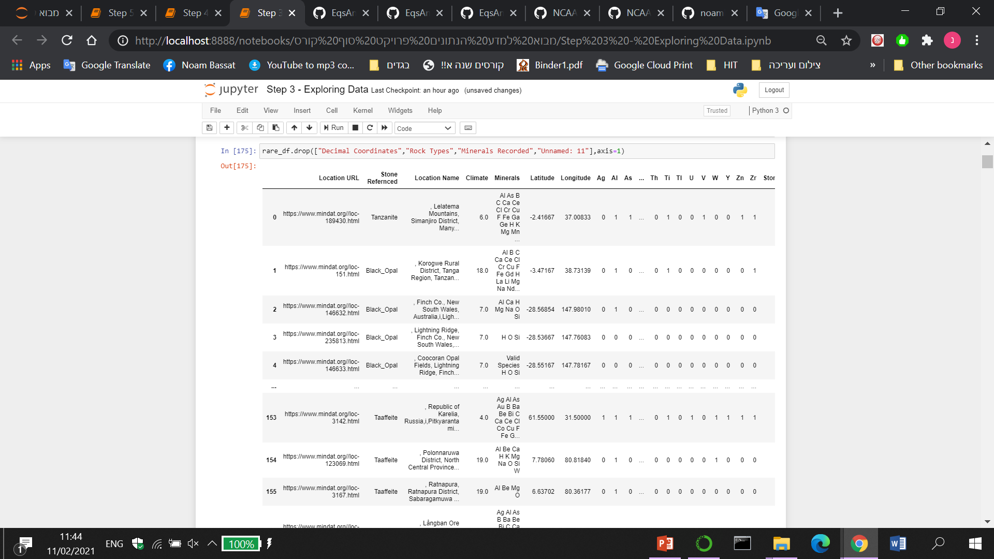



+Bonus:
The rarest stones in the world
I repeated the whole process to another dataframe, that contains 11 stones that are the rarest in the world.

Slide 25


My final machine

Slide 26

Conclusions
“Lapis Lazuli” and “Unakite” are found in almost every location in the data, with other gems.
Based on my features, the location coordinates are the most significant attribute.
You can predict a stone group by a given location.
With a little more time I would…
Add some quantitative data, for example - how many gems were found in each location.
Focus on specific gems with low correlation, which may be possible to define in different locations.
Split the main dataframe by one stone for each location row.
Develop the rare-stone dataframe, and build an algorithm that can predict the exact locations, by a given rare-stone name.
Make a geology and geographical research, and add some relative features.

Slide 27


THANKS FOR WATCHING

